Slide 1
(How) Do free charges end up on the surface?
We learn from textbooks that all free charges in a conductor flow to the outer surface to reach an equilibrium configuration. There are also nice experimental demonstrations, e.g., the Faraday cage.
But how do the charges all end up on the surface? Mutual repulsion? But could they have not distributed throughout the entire volume, maximizing the distance between one another?
You might argue that the surface distribution actually has a lower energy. But how do they always reach that low-energy configuration? Or do they?
Here we simulate their dynamics (with hard-wall boundary conditions) to see what actually happens! As we’ll see, there are two important factors:
  There must be a mechanism to lose energy. Otherwise the charges don’t reach any equilibrium configuration. In conductors, electrons lose energy in collisions with atoms.
  Gauss’ law, which sets how fast the electric field of a point charge falls off with distance.

Slide 2
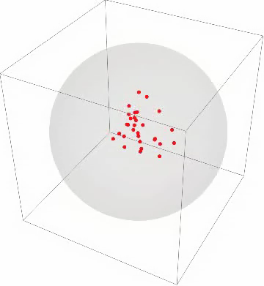
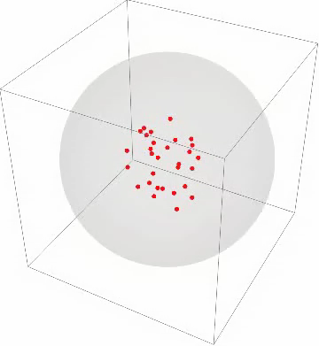
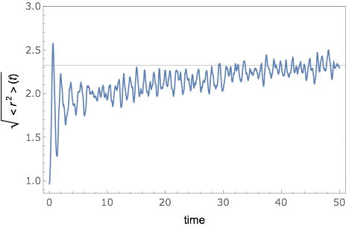
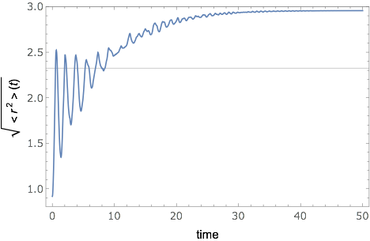

3D — with and without damping
No damping — charges don’t equilibrate
With damping — charges end up on surface

Slide 3
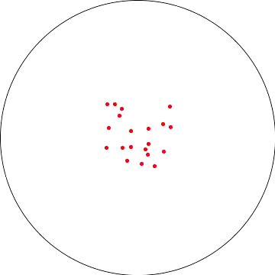
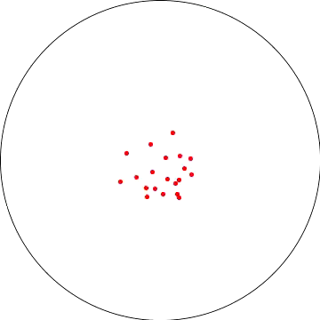
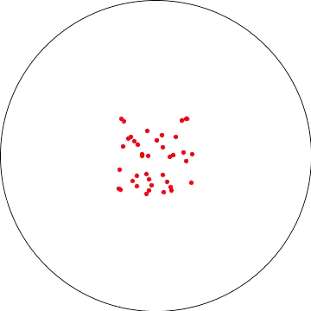
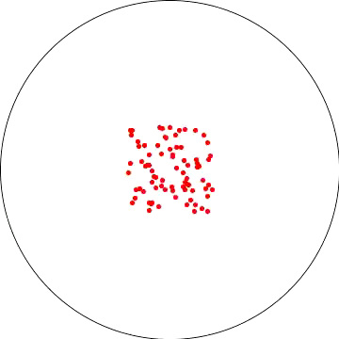
2D — with and without damping
No damping — charges don’t equilibrate
With damping, they self-organize into beautiful patterns! But weren’t they supposed to end up on the boundary?
With damping — 20 particles
With damping — 40 particles
With damping — 80 particles

Slide 4
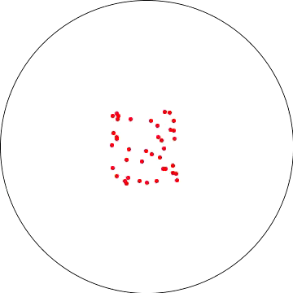
2D — 1/r^2 vs 1/r (with damping)
1/r^2
1/r
This is how charges distribute on a circular capacitor plate, which is a 2D surface embedded in 3+1 dimensions.
This is how charges will distribute in 2+1 dimensions. Thus a “flatlander” will also learn that free charges end up on the boundary.
More on the electrodynamics in a “Flatland” (2+1 spacetime dimensions):
Maxwell's equations of Electromagnetism in 2+1 spacetime dimensions
Can light exist in 2+1 or 1+1 spacetime dimensions?

Slide 5
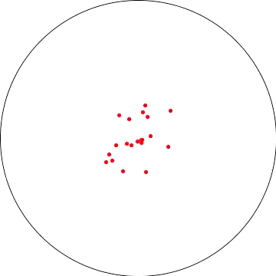
2D — 1/r^2 — initial state matters
1st run
2nd run
The charges are released from random locations within a square with zero initial speed

Slide 6
Food for thought
Its fascinating to see the charges spontaneously reaching such equilibrium configurations!
Questions to ponder:
(i) How does the number of particles decide the final charge configuration?
(ii) How does the initial state of the particles decide the final configuration?
(iii) Does the final distribution depend on the damping?
(iv) Does it matter how big the circle is?
(v) How would the result change if we had a different shape, instead of a circle?
Further reading:
(i) Fun with electrostatics, (ii) The charged conducting disk, (iii) Am. J. Phys. 65 (2), 155 (1997)

